Slide 1
Xtencion
A smart wrist wear that has BETTER USABILITY and BETTER FUNCTIONALITIES compared to traditional technology.

Slide 2


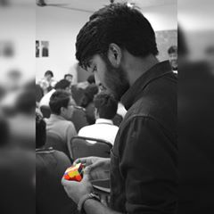
The Team
Swaroop Sudhanva Belur Suresh Senthil Kumar Chirag Mahaveer Parmar
IoT Developer Roboticist Electronics Engineer

Slide 3




The Problems with Smart Watches
1
Difficult to navigate interface
2
Very - Short Battery Life
3
Missing Distinct Features

Slide 4
The Validation - User Interviews
“My smartwatch is just like my phone, why did I waste money for something that I already have. I expected my smartwatch to have extra features in it” - Mr. Rajesh, Self-Employed Entrepreneur
“It’s difficult to navigate through the menu on such a small screen. I would opt for a smart watch with buttons on it for easier use.” - Ms. Lalitha, Fitness Freak

Slide 5
The Question
How can we make smartwatches a better tool and a better user experience for the end customer?

Slide 6
The Solution
We have built Xtencion, an intelligent wrist wear that has unparalleled functionality, improves the users’ productivity and efficiency while at the same time does not boggle the user with complicated user interfaces.

Slide 7
Design

Slide 8
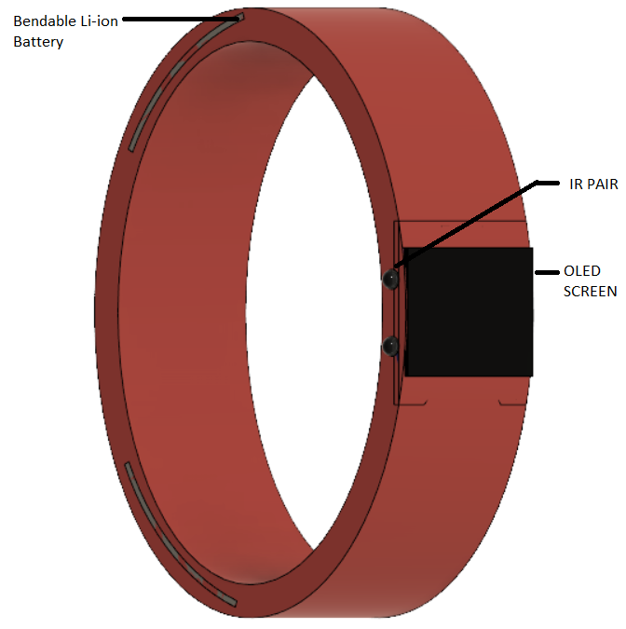
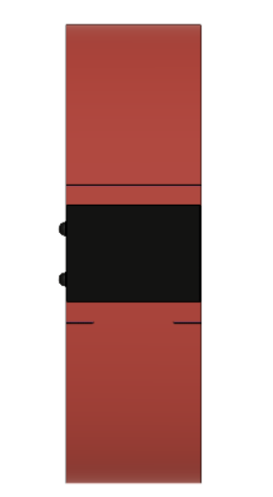
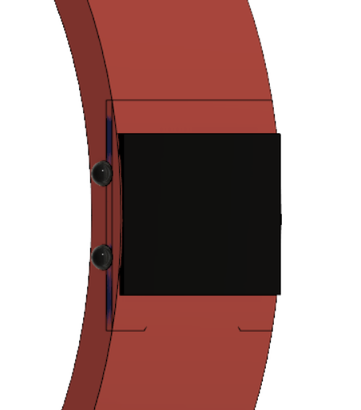
Design

Slide 9




The Features
It is gesture controlled, so no more tapping the wrong thing and wasting time going back and attempting to tap again.
It will reduce battery usage by nearly 50% by removing the touchscreen. The device will, additionally, use low power sensors.
The device will have virtually an infinite number of gestures since new gestures can be added and each gesture can be customised.
The gestures are location based and time based so the user doesn’t have to remember different patterns of gestures

Slide 10
The Working (Design Methodology)
The Xtencion band is equipped with a SHARP IR distance sensor to detect the different swipe gestures and a 6DOF gyro module to read the wrist gestures. The band recognizes either individual gestures or a combination of them.
After recognition it either navigates through the menu or triggers an external event based on the pattern of the gestures. This way we provide a hassle free usability for the user.
Since it is powered by a ESP32 (which has WiFi and Bluetooth onboard) connecting to other IoT devices is a breeze. The band controls other devices through a third-party service called IFTTT.

Slide 11
The Working (Design Methodology)
IFTTT (stands for If This Then That) is a platform that enables interface between various devices. We plan to deploy Xtencion “Recipe” Blocks on their platform so that the user can customise external events. This way we provide extended functionality to the user.
The band is powered by bendable lithium ion batteries which ensure maximum packing density and greater battery capacity. Such use of technology eliminates the biggest drawback of current smartwatches.

Slide 12


The 3P Design Specifications
POWER
PRECISION
PROTOCOL
Range
4cm - 30cm
Accuracy
1mm
Hypertext
Transfer
Protocol
Bluetooth
4.0
6 Days
* The price represent the design cost and not the cost of the product itself. If you were to design on your own it would cost you the above mentioned price.

Slide 13

The Eiffel Tower
...is where I’d like to go next!

